Slide 1

Optimizing
Business Travel Budget Management in
Grab Business Portal
Digital Empowerment Hackjakarta Submission by Rival Team

Slide 2
Background
Fraud in business travel spending costs U.S. businesses over $2.8 billion annually, with common types of fraud including personal expense claims, fictitious expense claims, multiple claims, and inflated expenses.
Personal Expense Claims
Fictitious Expense Claims
Multiple and Inefficient Claims
Inflated Expense
is a comprehensive platform designed to streamline corporate transportation, meal management, and more. It provides tools for managing employee expenses, setting spending policies, and gaining insights into company-wide expenditure.

Slide 3
Challenge Statement
Lack of visibility, automation, and monitoring on business travel budget planning, enable employees to commit fraudulent practices.
Why
Why
Why
Fraud or Misuse Expense
Weak Policies / Monitoring System
Manual Process
Lack of Oversight/ Automation
Misuse or submit false claim by employees
Weak policies and monitoring system create a gap for fraud activity
Company relies on manual review and planning process. So the company give too much flexibility to employe on budget expense planning
The company has not implemented an automated system that can increase the visibility, and enhance accuracy, as well as efficiency on budget planning.

Slide 4
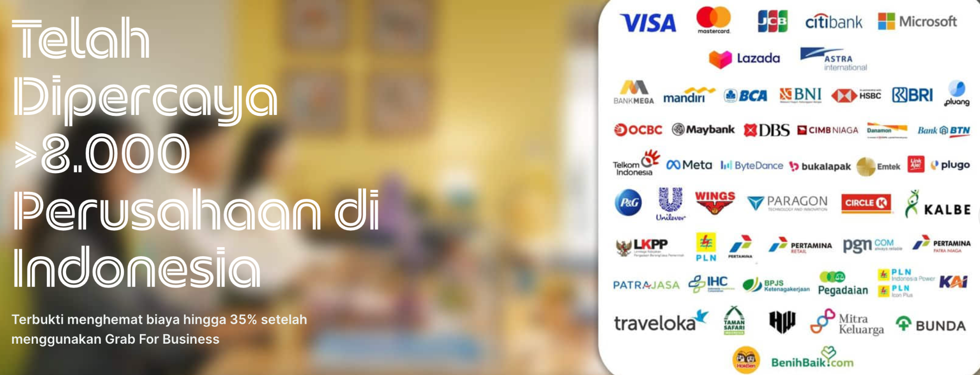
And now..
Imagine there are >8.000 Companies in Indonesia facing the same challenge..
How much does this fraudulent practices impact the company's costs?

Slide 5
Hypotheses
By giving more visibility and ability to finance team to plan and distribute the budget to the employees, it can give more efficient budget planning and distribution, as well as reduce misuse of expense.
More control from the Company >>
Less Control by Employee >>
Less Fraudulent Activities

Slide 6
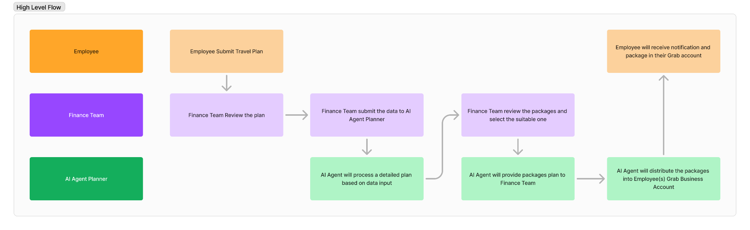
Solution
AI Agent for Business Travel Budget Planner in Grab Business Portal-Corporate Account that will help Company (Finance Team) manage Business Travel Plan, Optimize Budget more efficiently, and Distribute itinerary to employees automatically.

Slide 7
Potential Impact
By enabling our budget planner it can offers various benefit for both Grab and Companies.
Reduce fraud case
Increase cost efficiency
Increase user retention
Increase user acquisition

Slide 8
Roadmap
PoC (current)
Improve Model Quality
Make more seamless user experience
Expand capability for group of employee (bulk) submission
AI Agent business travel planning focused for individual employee
Improve accuracy
Add more guardrail to reduce hallucination
RAG, Finetunning Model
Once the AI Agent can have good performance on the PoC, we will focus on improving user experience (more engaging UI/UX etc, including integration to Hotel/Travel Aggregator
Enable employee to submit in bulk, and get personalized planning for each member

Slide 9
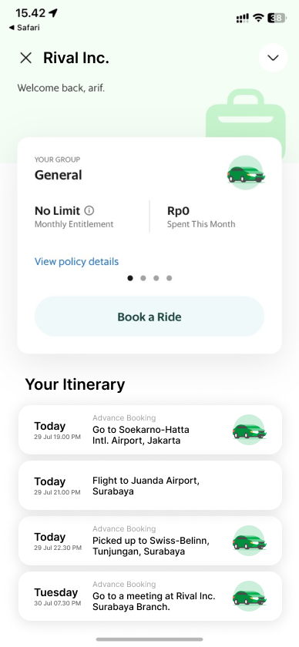

Demo
Grab Business Portal - Admin
The itinerary will be sent to Grab Business Account -
Employee

Slide 10
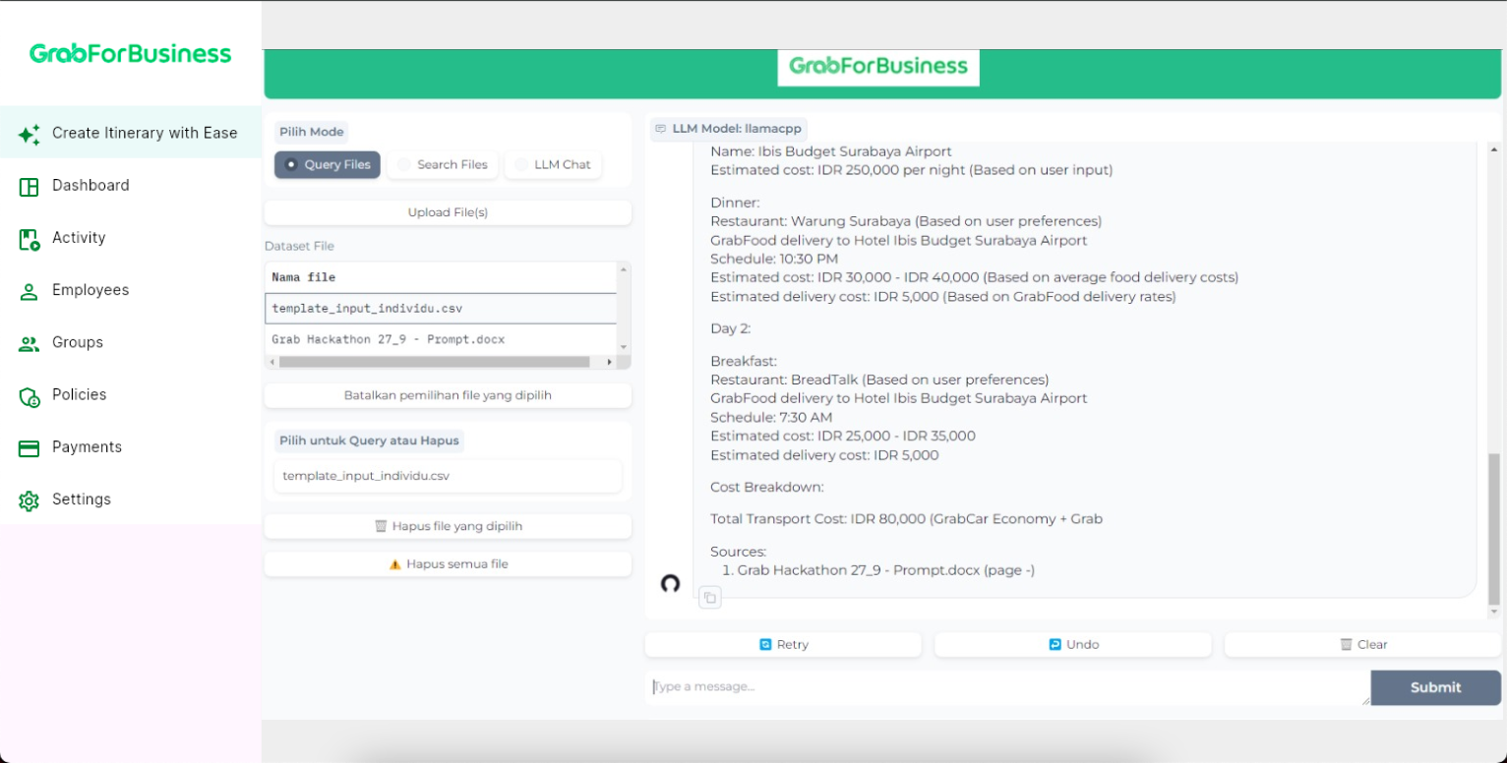
Demo
Grab Business Portal - Admin
The itinerary will be sent to Grab Business Account -
Employee

Slide 11

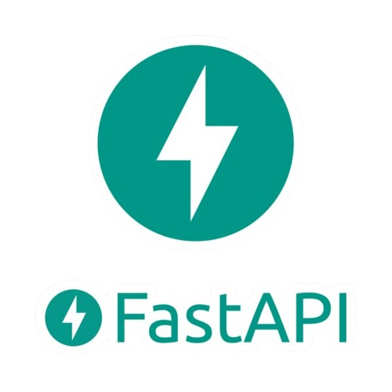




Tech Stack
Interactive interface to deploy developed models, without requiring much effort in terms of front-end.
A framework for building APIs in Python. Very fast and efficient
Using Ollama 7B
Vector database for semantic search and vector-based data management. Can understand user questions based on semantic meaning and search for relevant answers even if the wording is different.
Provides cloud-based computing resources that are affordable and easy to access.
Build, test, and deploy beautiful mobile, web, desktop, and embedded apps from a single codebase.

Slide 12
Rival Team
Revaldi
AI Engineer and Backend Engineer
Arif
PM & FE
Titan
PM & Prompt Engineer

Slide 13
Thank You

Slide 14
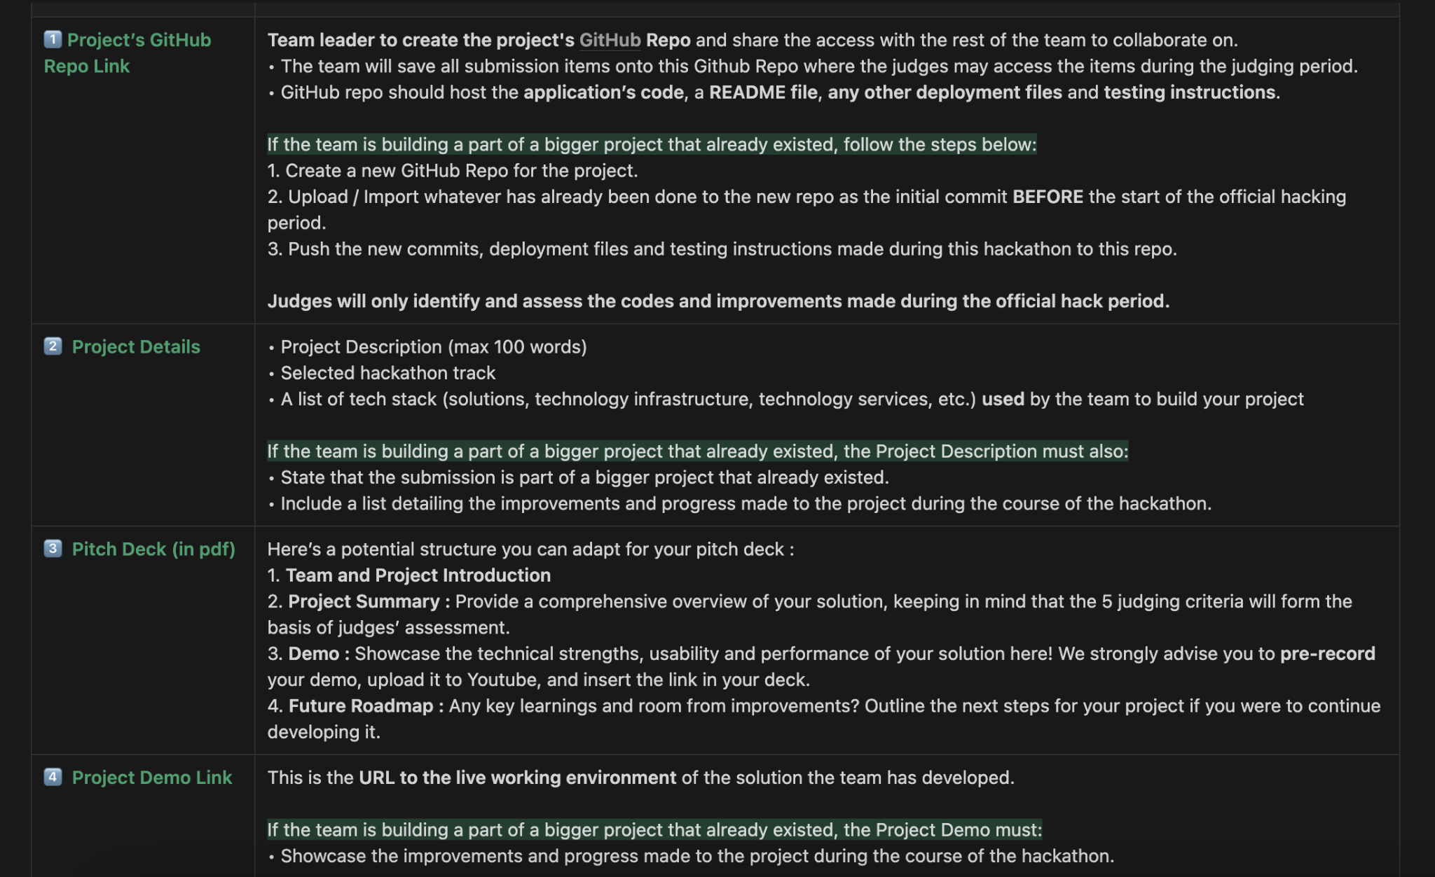

Slide 15
Project Details
Project Description:
Fraud in business travel spending costs U.S. businesses over $2.8 billion annually, with common types of fraud including personal expense claims, fictitious expense claims, multiple claims, and inflated expenses. We propose a Gen AI-powered business travel budget planner designed to assist finance teams in planning trips and accurately distributing potential expenses such as transport, food, hotel, and flight to employees. This planner will seamlessly integrate into Grab for Business Corporate accounts and employee’s Grab business accounts. The key objectives of this solution are to:
1. Optimize Budget Planning while minimizing fraud and over spending
2. Streamline Approval Processes
Selected hackathon track:
Digital Empowerment
Tech stack:
A list of tech stack (solutions, technology infrastructure, technology services, etc.) used by the team to build your project

Slide 16
Tech Stack
interactive interface to deploy developed models, without requiring much effort in terms of front-end.
A framework for building APIs in Python. Very fast and efficient
Vector database for semantic search and vector-based data management. Can understand user questions based on semantic meaning and search for relevant answers even if the wording is different.
provides cloud-based computing resources that are affordable and easy to access.
Using Ollama 7B

